Slide 1
FALCON SALES INSIGHT REPORT
Objective :
This is the Falcon Sales Insight Data Analysis Project.
Our objective is to find the Total Revenue, Total Sales Quantity, Revenue Growth, Top 5 Products, Top 5 Customers.
In this project we used some csv files for our fact and dimension tables. We used Azure Databricks for Data load and Transformations.
After made all transformation in Databricks, we load these tables into Power BI and build some meaningful insight

Slide 2



Project Architecture
customers.csv
date.csv
Markets.csv
Products.csv
Transaction.csv
FALCON_STG_CUSTOMER
FALCON_STG_DATE
FALCON_STG_MARKET
FALCON_STG_PRODUCTS
FALCON_STG_TRANSACTION
Falcon_Sales_Insight.pbix

Slide 3
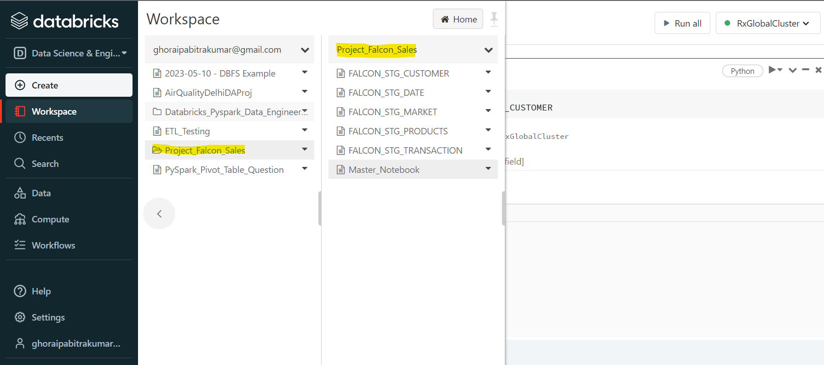
Azure Databricks :
Azure Databricks is a Microsoft Azure implementation of Apache Spark. Spark clusters, which are completely managed, are used to process big data workloads and also aid in data engineering, data exploration, and data visualization utilizing machine learning.
Here we use Azure Databricks for load csv files and transform csv files into SQL tables.

Slide 4
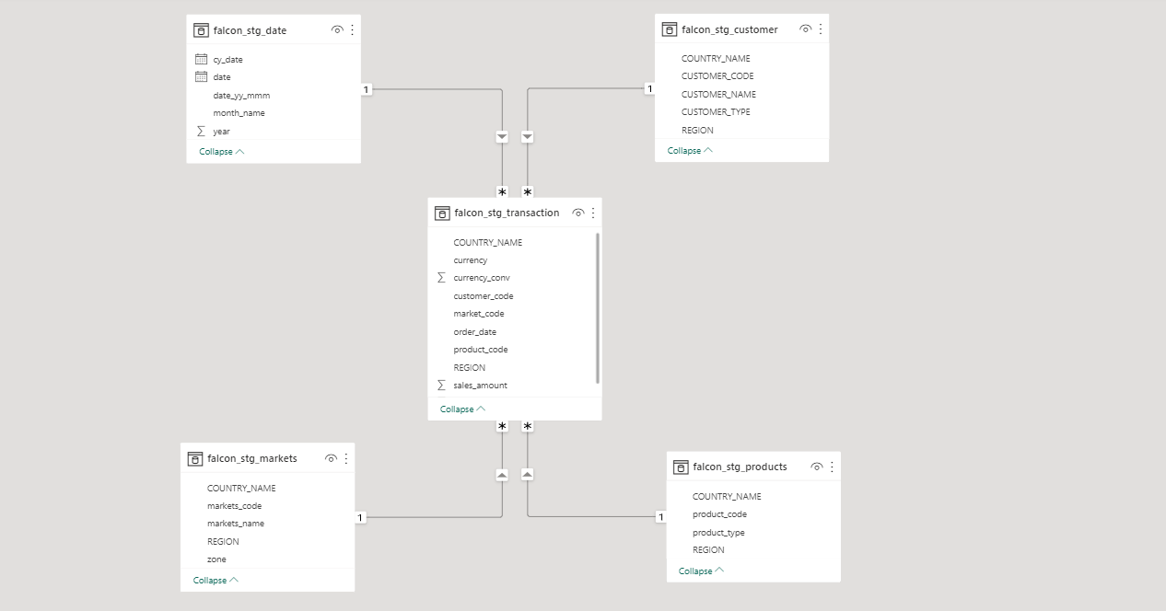
Power BI Model View :

Slide 5
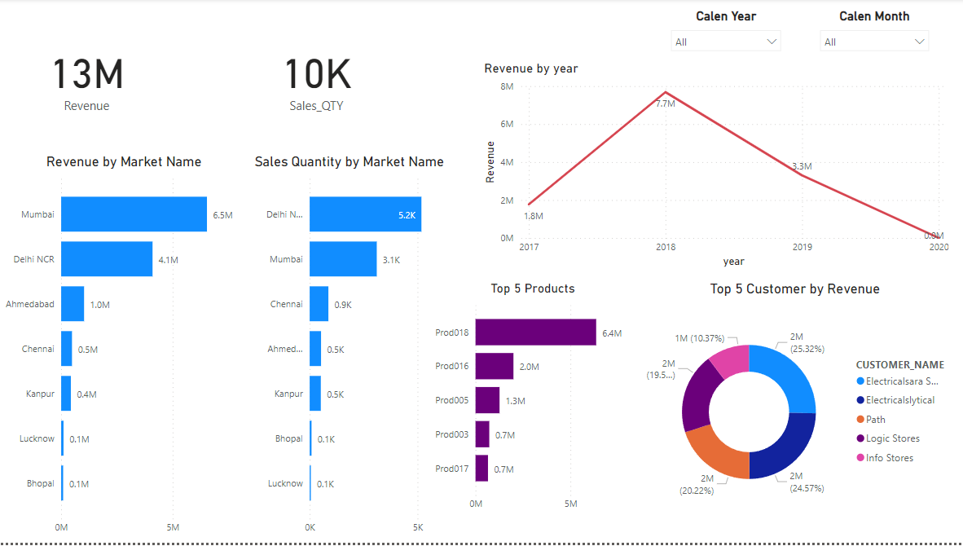
Data Insight in Power BI :

